Slide 2
Total Sample Variance
1e+05
8e+04
6e+04
4e+04
2e+04
0e+00
DO
3.5 mg/l - 90 s
4.0 mg/L - 90 s
4.0 mg/L - 300 s

Slide 3
3.5 vs DO
Difference of TSV
Ratio of TSV
Observed difference 13637
Observed ratio 1.14
0.00012
12
10
0.00008
8
6
0.00004
4
2
0.00000
0
-10000
-5000
0
5000
10000
0.90
0.95
1.00
1.05
1.10

Slide 4
DO vs 4.0 - 90
Difference of TSV
Ratio of TSV
Observed difference 32967
Observed ratio 1.49
15
0.00015
10
0.00010
5
0.00005
0.00000
0
-10000
0
10000
20000
30000
0.9
1.0
1.1
1.2
1.3
1.4
1.5

Slide 5
4.0 - 90 vs 4.0 - 300
Difference of TSV
Ratio of TSV
Observed difference 19201
Observed ratio 1.4
0.00025
15
0.00020
10
0.00015
0.00010
5
0.00005
0.00000
0
-5000
0
5000
10000
15000
20000
0.9
1.0
1.1
1.2
1.3
1.4

Slide 12
AB3 Z7 Ammonia
1.0
0.5
ACF
0.0
-0.5
0
1
2
3
Days

Slide 13
Model Component R-squared for 4.0 mg/L - 300 s
AB3-4-300: 3day Window, Model Component R^2
0.8
0.8
R-squared
R-squared
0.4
0.4
Diurnal
Diurnal
Adaptive
Adaptive
Total
Total
0.0
0.0
10
20
30
40
50
60
70
10
20
30
40
50
60
70
Forecast Horizon (minutes)
Forecast Horizon (minutes)

Slide 14
AB3 Z7 Ammonia
1.0
0.6
ACF
0.2
-0.2
0
1
2
3
Days

Slide 15
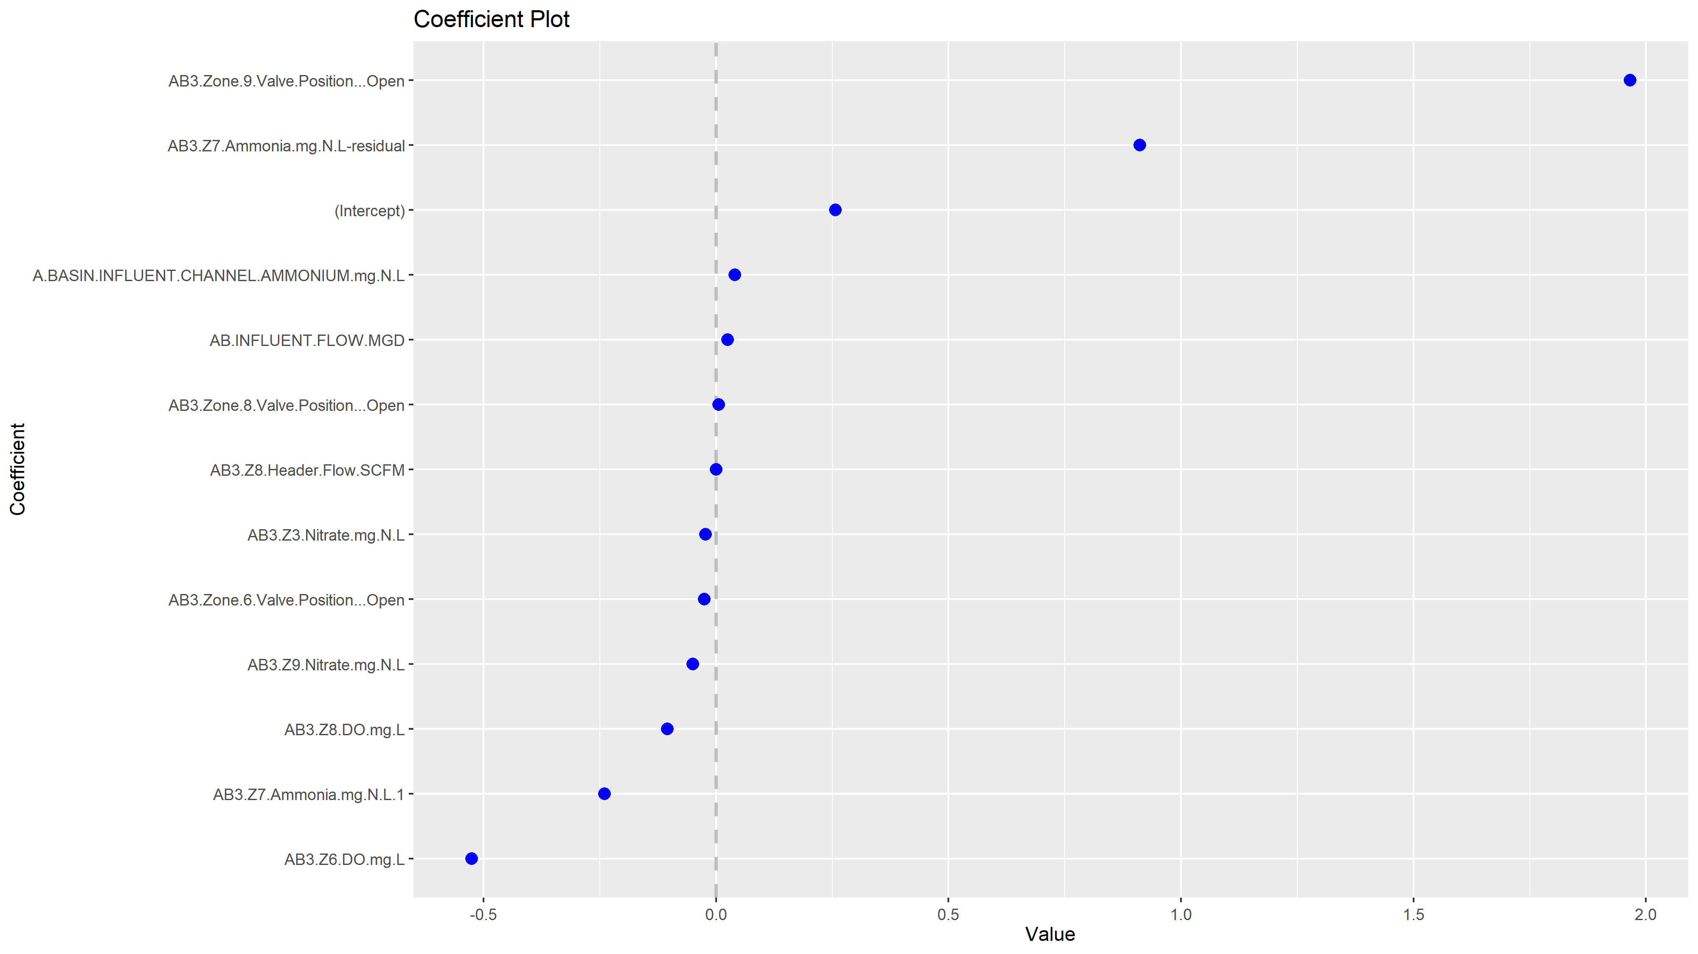

Slide 16
GLM Coefficient Absolute Value
Zone 9 Valve Position
Residual Z7 Ammonia
Z6 DO
Z7 Ammonia 1
Z9 Nitrate
(Intercept)
Z8 DO
Influent Ammonia
Zone 6 Valve Position
Z3 Nitrate
Influent Flow
0.0
0.2
0.4
0.6
0.8
1.0
1.2
1.4

Slide 17
AB3-4-300: 3day Window, R^2 by Horizon
5 min
10 min
15 min
20 min
25 min
30 min
35 min
40 min
45 min
50 min
55 min
60 min
65 min
70 min
75 min
Diurnal
Ammonia
0.8
60
55
0.6
50
R squared
Influent Ammonia
0.4
45
0.2
40
35
Sat
Sun
Mon
Tue

Slide 18
AB3-4-300: 3day Window, R^2 by Horizon
0.8
60
55
0.6
50
R squared
Influent Ammonia
0.4
45
0.2
40
35
Sat
Sun
Mon
Tue

Slide 19
AB3-4-300: 3day Window, 50 Minute Forecasts
5
Actual
Model
4
3
Ammonia Zone 7 (mg/L)
2
1
0
Sat
Sun
Mon
Tue

Slide 20
AB3-4-300: 3day Window, 50 Minute Errors
1.5
Model
Persistence
1.0
0.5
Ammonia Errors (mg/L)
0.0
-0.5
-1.0
-1.5
Sat
Sun
Mon
Tue

Slide 21
Diurnal Trend in Ammonia in Zone 7
12
10
8
Ammonia (mg/L N)
6
4
2
0
1
2
3
4
5
6
7
8
9
10
11
12
13
14
15
16
17
18
19
20
21
22
23
24
Hour of the Day

Slide 22
Diurnal Trend in Ammonia in Zone 7
3
2
1
Adjusted Ammonia
0
-1
-2
1
2
3
4
5
6
7
8
9
10
11
12
13
14
15
16
17
18
19
20
21
22
23
24
Hour of the Day

Slide 23
GLM Coefficient Absolute Value
Residual Z7 Ammonia
Z6 DO
(Intercept)
Z7 Ammonia 1
Z8 DO
Z3 Nitrate
Influent Ammonia
Zone 6 Valve Position
Influent Flow
0.0
0.2
0.4
0.6

Slide 24
ab3_do
8
3.0
6
2.5
Z7 Ammonia (mg/L N)
Z6 DO (mg/L)
4
2.0
2
1.5
01/01
01/02
01/03
01/04
01/05

Slide 25
ab3_3.5
3.0
6
2.5
Z7 Ammonia (mg/L N)
Z6 DO (mg/L)
4
2.0
2
1.5
04/18
04/19
04/20
04/21
04/22

Slide 26
ab3_4.0
6
2.5
5
4
2.0
Z7 Ammonia (mg/L N)
Z6 DO (mg/L)
3
2
1.5
1
0
1.0
04/30
05/01
05/02
05/03
05/04

Slide 27
ab3_4.0_300
6
5
2.5
4
3
2.0
Z7 Ammonia (mg/L N)
Z6 DO (mg/L)
2
1.5
1
0
1.0
05/14
05/15
05/16
05/17
05/18

Slide 28
20
2500
15
2000
1500
Total Airflow (SCFM)
Z7 Ammonia (mg/L N)
10
1000
5
500
0
0
Days

